Slide 1
Lecture 4

Slide 2
Pointer Increments & Scale factor
When we increment a pointer, it’s value is increased by the length of the data type it points to. This is called the scale factor.
A pointer variable can be pre-fixed or post-fixed with increment or decrement operators.
p1++;
An integer value may be added or subtracted from a pointer variable.
New Address=Current Address+(n×sizeof(data type))
When two pointers point to the same array, one pointer variable can be subtracted from another.

Slide 3
Continue…
#of steps taken ptr1 to reach ptr2 = ptr1 ​− ptr2​ / sizeof(type)
When two pointers point to objects of the same data types, they can be compared using relational operators.
relational operators : ==, !=, <, >, <=, >=
ex: ptr1 == ptr2
A pointer variable can not be multiplied by a constant.

Slide 4
Legal vs illegal arithmetic operation with a pointer
Operation | Syntax | Status | Result
Addition | Pointer + Integer | Legal | New pointer (offset by n elements)
Subtraction | Pointer - Integer | Legal | New pointer (moved back n elements)
Difference | Pointer - Pointer | Legal | Integer (distance between elements)
Multiplication | Pointer*Constant | Illegal | Compiler Error
Division | Pointer/Constant | Illegal | Compiler Error

Slide 5
Continue…
Two pointer variables can not be added
A value cannot be assigned to an arbitrary address
&x = 10; // illegal because the address of a variable is a read-only value

Slide 6
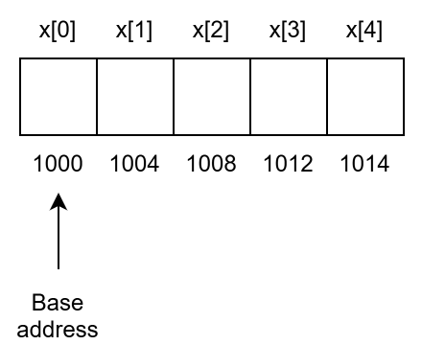
Pointers & Arrays
int x[5] = {1, 2, 3, 4, 5};
X = &x[0] = 1000
p = x or p = &x[0]; //p is pointer variable
p+1 = &x[1] = 1004
p+2 = &x[2] = 1008 and so on
Address of x[3] = base address + (3 * scale factor of int)

Slide 7
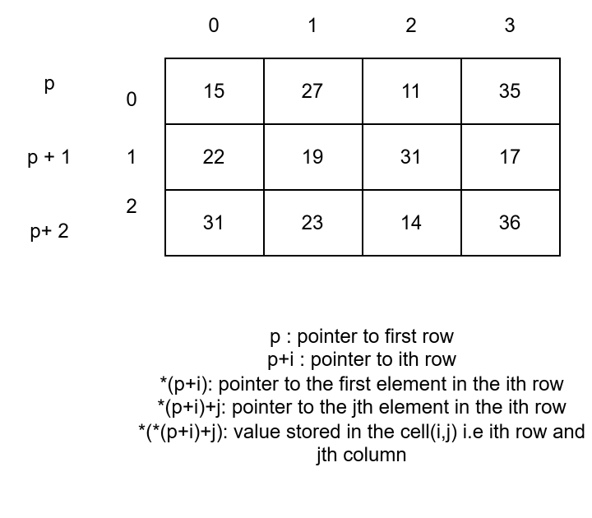
Pointer to a two-dimensional array

Slide 8
Continue…
int main(){
int a[3][4] = { {15, 27, 11, 35 },
{22, 19, 31, 17},
{31, 23, 14, 36} };
int (*p)[4] = a;
for(int i = 0; i < 3; i++){
for(int j = 0; j < 4; j++){
printf("%d ", *(*(p+i)+j));
}
printf("\n");
}
return 0;
}

